Slide 1
B37VB2
C Programming for Engineers
Unit 0: Computers

Slide 2
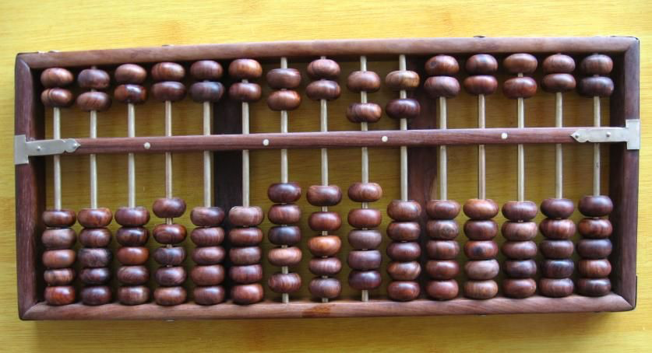
First computer
Science： Theory、experiment、computation
Abacus 2000 years

Slide 3
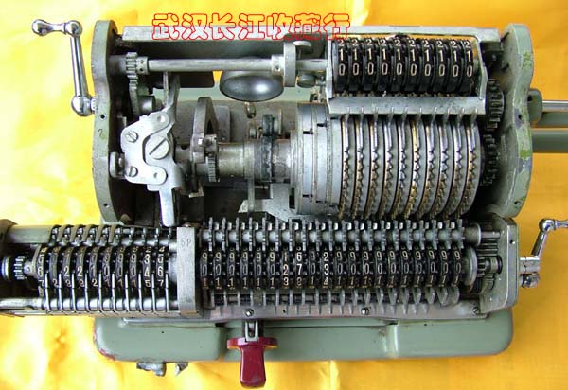
Manual computer
Pascal 1600s
  Addition
  Subtraction
Leibnitz 1700s
  Multiplication
Not computer
  No memory
  Non-programmable

Slide 4
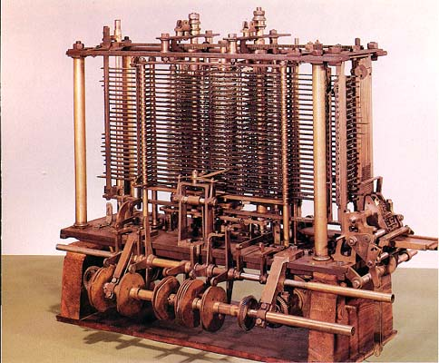
Mechanical Computer
Charles Babbage 1800s
Lucasian professor
  Isaac Newton
  Stephen Hawking
Difference engine
  Solve differential equations
Analytical engine
  Condition branch
  Loop
First programmable machine
  Punched card as input， driven by stream，CPU，Memory，I/O
  Ada Byron（daughter of lord Byron）

Slide 5
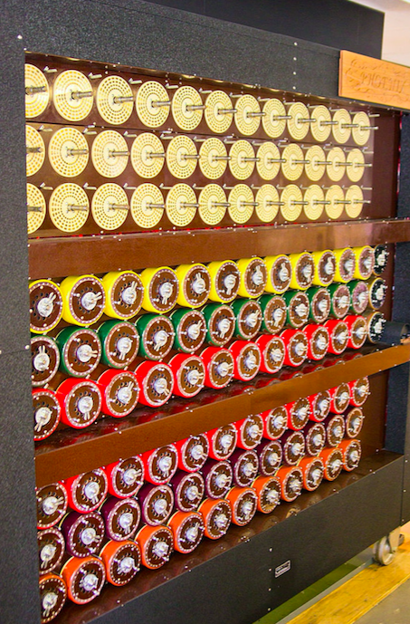
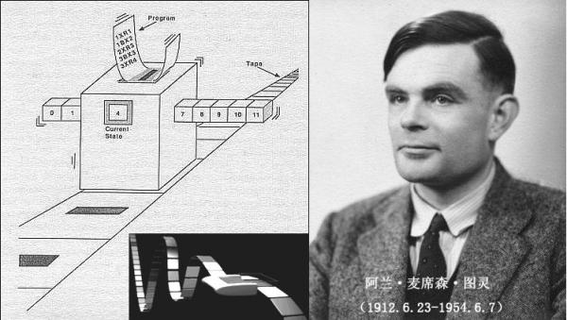
Alan Turing
Turing Machine
  A infinite tape（Memory and I/O）
  A read and write head（program counter）
  A state register（instructions）
  A finite table（Program）
Turing Award
  Nobel prize in computer
Turing Test
  Artificial Intelligence
Engima decrypt
  Bombe
  IBM
Apple
Notes:
Alan Turing is homosextual which we called “Gay”.

Slide 6
John Von Neumann
First Draft of a Report on the EDVAC
  Von Neumann Architecture
  The father of computer
Two basic features of digital computer
  Binary system
  Execute with program
Components of computer：
  ALU（arithmetic logic unit）
  Controller
  Memory
  Input device
  Output device

Slide 7
Modern Digital Computer
Vacuum Tube(1946-1957)
  ENIAC（U.S.）
  EDSAC(U.K.)
Transistor(1958-1964)
  IBM 650 704
MSI/LSI/VLSI(1965-2015)
  CPU Intel 4004, 8086, x86
  DRAM Memory(IBM)
  Hard drive（Floppy disk，hard disk，optical disk， solid disk）
Multi-processors(Moore’s Law)(2000-2015)
  Multi CPU cores
  GPUs（NVIDIA、AMD）
  Others（Xeon Phi、Tilera、DSP）

Slide 8
Programming Language
Computer language
Assemble language
Fortran：1957
COBOL：1959
BASIC：1964
C：1969
PASCAL：1970
C++:1983
PERL：1987
PYTHON：1991
JAVA：1995
Dennis Ritchie
Bell Lab
“The C Programming Language”

Slide 9
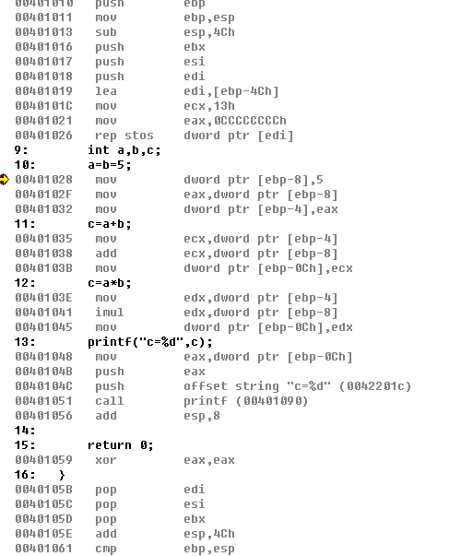
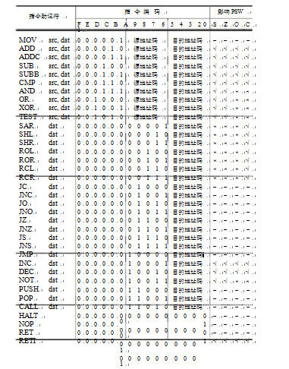
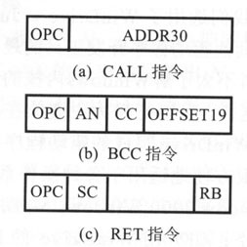
Instructions
CPU instructions
  Binary code
  Machine-level instructions
Mnemonic Symbols
  Assemble language
Natural Language
  High-level language
00000001000000001000
00000001000100001010
00000101000000000001
00000001000100001100
00000100000000000001
00000010000000001110

Slide 10
Programming
Edit your source code
  IDE software： VC++6.0，VS2012，Xcode，Eclipse
Compile all source code
  Check syntax error
  Compile to assemble language
Link the objective files
  Link all files together
  Generate executable file：EXE（windows），Target file（linux &Unix）
Execute your code（For C only）
  Run in terminal window
  Input & output in terminal window

Slide 11
Homework
Check out the configuration of your laptop
  How many cores？Frequency？
  Size of Memory？ Bus width of Address？ 32 or 64？
  Storage of your disk？HDD or SSD？
  GPU card？Maximum Display resolution？
What’s the difference between C and C++？
  Other object-oriented languages？
What is a console application？
How many steps from C source code to executable application？

